Slide 1


Test Automation Using Selenium
Fair Hike Academy
That’s the way the cookie crumbles!
Session 18: TestNG Parallel Execution & Log4j
Mentor : Naresh Vulli, CSTE, PAHM.
fairhike@gmail.com www.fairhike.blogspot.com | www.facebook.com/fairhike

Slide 2
Today’s Topics
Recap
TestNG Parallel Test Execution
Log4j
Properties File
Class level Commands
Review logs
Takeaways or Exercise

Slide 3
TestNG – Parallel execution
<?xml version="1.0" encoding="UTF-8"?>
<!DOCTYPE suite SYSTEM "http://testng.org/testng-1.0.dtd">
<suite name="TestSuite1" parallel="classes" thread-count="2" >
<test verbose="2" name="Test1">
<classes>
<class name="testPkg.TestNGExample"/>
<class name="testPkg.GoogleSrch_Firefox"/>
</classes>
</test>
</suite>

Slide 4
TestNG – Parallel tests execution
<?xml version="1.0" encoding="UTF-8"?>
<!DOCTYPE suite SYSTEM "http://testng.org/testng-1.0.dtd">
<suite name="TestSuite1" parallel = "tests" thread-count="2">
<test verbose="2" name="Test1">
<classes>
<class name="testPkg.TestNGExample"/>
</classes>
</test>
<test verbose="2" name="Test2">
<classes>
<class name="testPkg.GoogleSrch_Firefox"/>
</classes>
</test>
</suite>

Slide 5
Log4j
To record and store intricate details of the execution
Loggers
All
DEBUG
INFO
WARN
ERROR
FATAL
Appenders
Rolling file appender to a file with maximum size
Layout
PatternLayout

Slide 6
Properties File
# Root logger option
log4j.rootLogger=ALL, ROOT
# Direct execution All root log messages to a rootlogs.log file
log4j.appender.ROOT=org.apache.log4j.RollingFileAppender
log4j.appender.ROOT.File=./logs/rootlogs.log
log4j.appender.ROOT.MaxFileSize=500KB
log4j.appender.ROOT.Append=true
log4j.appender.ROOT.MaxBackupIndex=2
log4j.appender.ROOT.layout=org.apache.log4j.PatternLayout
log4j.appender.ROOT.layout.ConversionPattern=%d{yyyy-MM-dd HH:mm:ss} %-5p [%c{1}] - %m%n

Slide 7
Class level commands
static Logger logger = Logger.getLogger("executionlog");
PropertyConfigurator.configure("./logs/log4j.properties");
logger.error("Logged Error message");
logger.info("Logged Info Message");
logger.debug("Logged Debug Message");
logger.warn("Logged Warning Message");
logger.fatal("Logged Fatal Message");

Slide 8
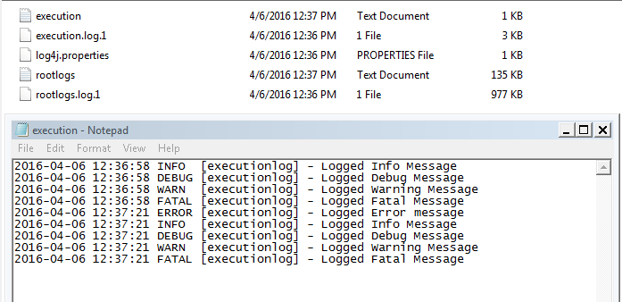
Review the logs

Slide 9
Takeaway or Exercise
Setup a logger properties file for any two existing program and execute them in parallel

Slide 10
Q & A

Slide 11
Thank You ☺

